Slide 1
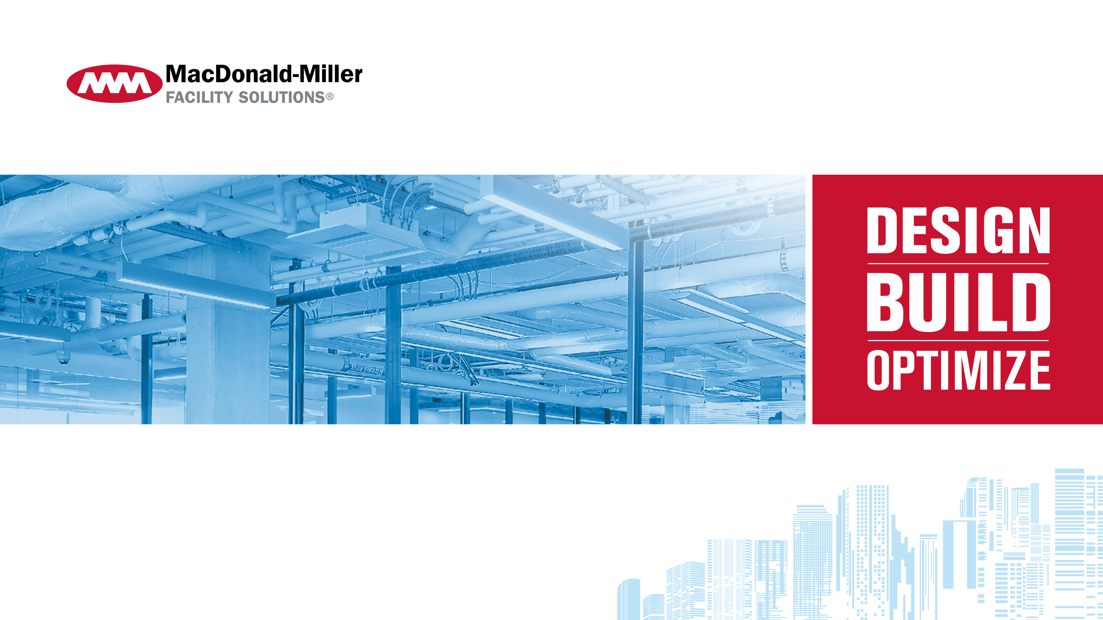
HEERF & ELIGIBILE UPGRADES

Slide 2







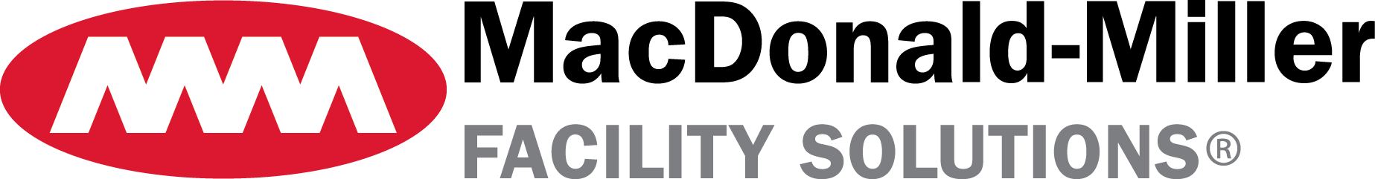
Presenters
Michael Coffey
ESCO Account Executive
Christian Barlow
Chair of the Board
Adam Corwin
Chief Executive Officer

Slide 3
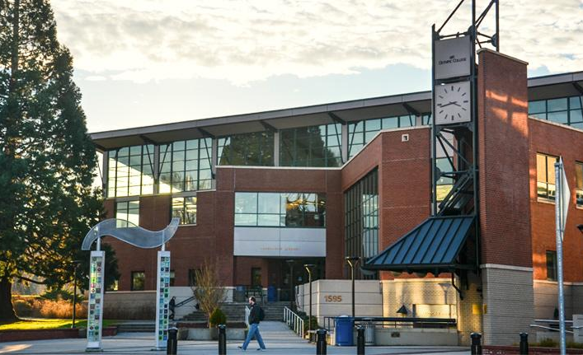
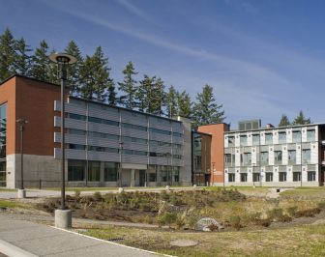
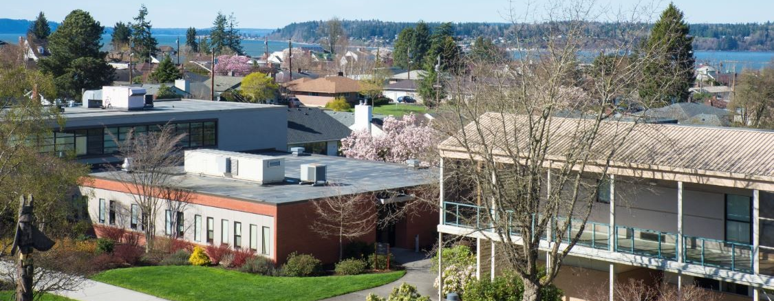
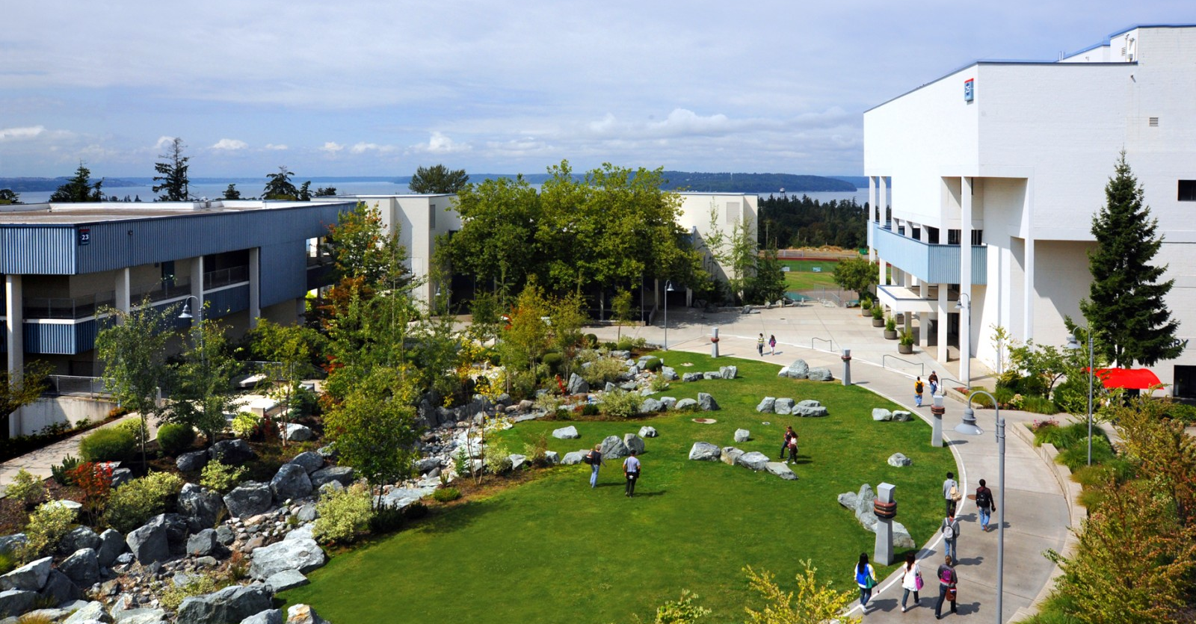
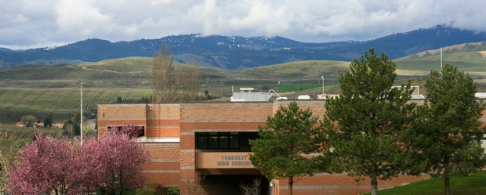
About MacDonald-Miller
Full-service design/build mechanical/controls/ ESCO contractor with 10 offices throughout Washington and Oregon.
In business since 1965
1,300+ Employees
Fleet of 140 Service Technicians
Happy Clients
Highline College
Seattle Central College
UW Bothell
Klamath College
Wenatchee College
Olympic College
Bates Technical College
Everett College
Tonasket School District
Northshore School District
Portland Public Schools
Notes:
Michael

Slide 4
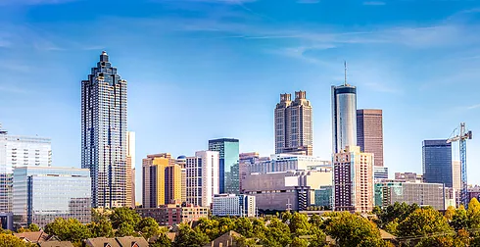





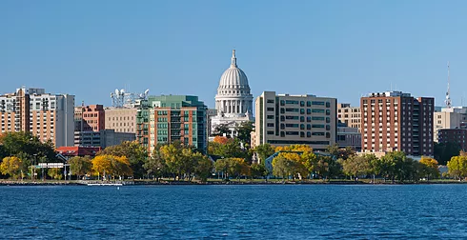




About Centrix –
A National network of energy efficiency experts that are delivering cost-effective upgrades on a local basis.
Our regional partners are local self-starters who are committed to helping their customers succeed and are supported logistically and financially by the parent company. We provide technical expertise and personalized service to local communities, while also leveraging the financial strength of our nationwide network.
Atlanta, Georgia
Boston, Massachusetts
New Orleans,
Louisianna
Denver,
Colorado
Little Rock,
Arkansas
Raleigh,
North Carolina
Madison, Wisconsin
Memphis,
Tennessee
Tampa,
Florida
Seattle,
Washington
Portland,
Oregon
Notes:
Michael

Slide 5


HEERF III
U.S. Department of Education
https://www2.ed.gov/about/offices/list/ope/heerfiiiinstitutional.html
On March 11, 2021, President Biden signed the American Rescue Plan Act of 2021 (ARP) (Pub. L. 117-2). The ARP appropriated approximately $39.6 billion for the Higher Education Emergency Relief Fund (HEERF) and represents the third stream of funding appropriated for HEERF to prevent, prepare for, and respond to coronavirus.
Taken together, the Coronavirus Aid, Relief, and Economic Security Act (CARES Act) (Pub. L. 116–136), the Coronavirus Response and Relief Supplemental Appropriations Act, 2021 (CRRSAA) (Pub. L. 116-260), and the ARP represent HEERF I, HEERF II, and HEERF III, respectively.
Notes:
Ben starts

Slide 6
HEERF III
U.S. Department of Education
New required uses of grant funds: The ARP has two new required uses of HEERF III Institutional Portion grant funds for public and private nonprofit institutions in which, if the Institutional Portion is not used entirely for emergency financial grants to students, a portion of funds must be used to:
implement evidence-based practices to monitor and suppress coronavirus in accordance with public health guidelines; &
conduct direct outreach to financial aid applicants about the opportunity to receive a financial aid adjustment due to the recent unemployment of a family member or independent student, or other circumstances, described in section 479A of the HEA.
Notes:
Ben starts

Slide 7
U.S. Department of Education
Improving Ventilation in Schools, Colleges, and Universities to Prevent COVID-19
Did you know? You can use American Rescue Plan (ARP) education funds further described below to improve indoor air quality for in-person instruction, including through: Inspection, testing, and maintenance of current ventilation systems and approaches
Purchasing portable air filtration units, such as HEPA air filters
Purchasing MERV-13 (or higher) filters for your HVAC system and ACs
Purchasing fans
Repairing windows and/or doors so that they can open to let fresh air in
Servicing or upgrading HVAC systems consistent with industry standards
Purchasing equipment to run outdoor classes
Purchasing carbon dioxide (CO2) monitors, air flow capture hoods, and anemometers for custodians and building personnel to assess ventilation
Paying for increased heating/cooling costs due to increased use of heating/cooling systems
Other spending that supports inspection, testing, maintenance, repair, replacement, and upgrade projects to improve the indoor air quality in school facilities, including mechanical and non-mechanical heating, ventilation, and air conditioning systems, filtering, purification and other air cleaning, fans, control systems, and window and door repair.
Notes:
Ben starts

Slide 8
COVID and Indoor Air Quality
What we know:
The virus is AIRBORNE
Highest risk of exposure is in poorly ventilated, indoor spaces without masks
COVID is very contagious, especially the new variants
Surface transmission risk is low
We must take a layered approach to mitigation
ASHRAE and CDC guidelines set the standard for building HVAC operation.
https://www.cdc.gov/coronavirus/2019-ncov/community/ventilation.html
https://www.ashrae.org/technical-resources/resources
Notes:
Ben starts

Slide 9

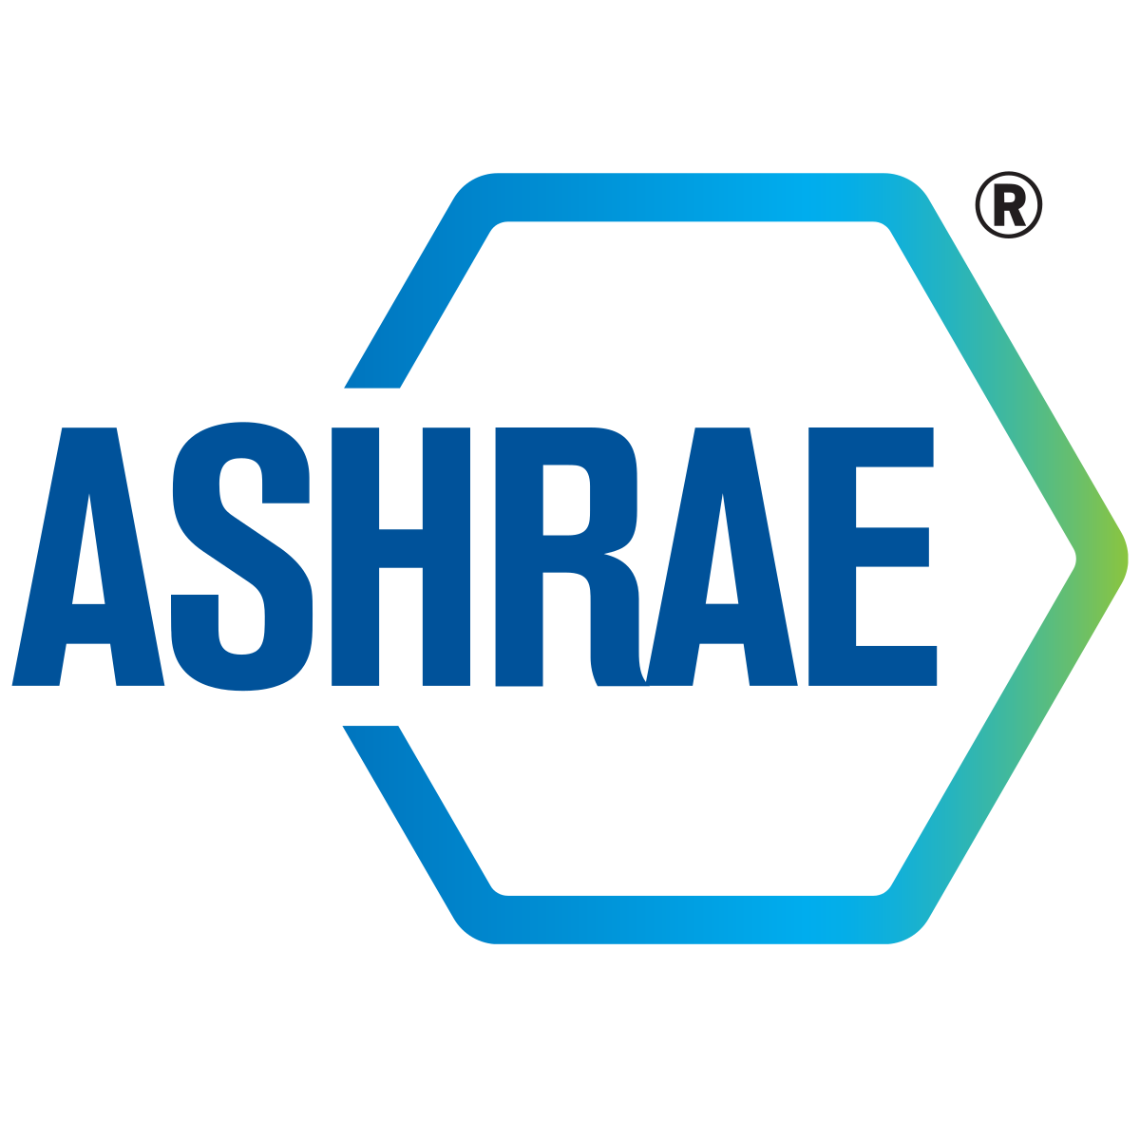

ASHRAE Core Recommendations
Reducing Airborne Exposure
Notes:
Ben

Slide 10
ASHRAE CORE RECOMMENDATIONS
The following recommendations are the basis for the detailed guidance issued by ASHRAE Epidemic Task Force. These are based on the concept that within limits, ventilation, filtration, and air cleaners can be deployed flexibly to achieve exposure reduction goals subject to constraints that may include comfort, energy use, and costs. This is done by setting targets for equivalent clean air supply rate and expressing the performance of filters, air cleaners, and other removal mechanisms in these terms.
https://www.ashrae.org/file%20library/technical%20resources/covid-19/core-recommendations-for-reducing-airborne-infectious-aerosol-exposure.pdf
Notes:
Ben

Slide 11
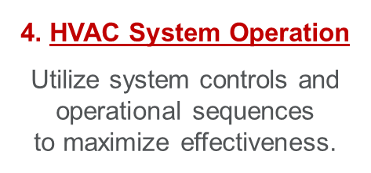
ASHRAE Core Recommendations:
1. Public Health Guidance
Follow all regulatory and statutory requirements and recommendations.
2. Ventilation, Filtration, Air Cleaning
Increased levels for
added safety.
3. Air Distribution
Avoid strong currents that may
increase direct transmission.
5. System Commissioning
Verify HVAC systems
are functioning as designed.
https://www.ashrae.org/file%20library/technical%20resources/covid-19/core-recommendations-for-reducing-airborne-infectious-aerosol-exposure.pdf
Notes:
Seth- point out the 5 recommendations and that we are talking about the 2 in red- #2 & #4

Slide 12
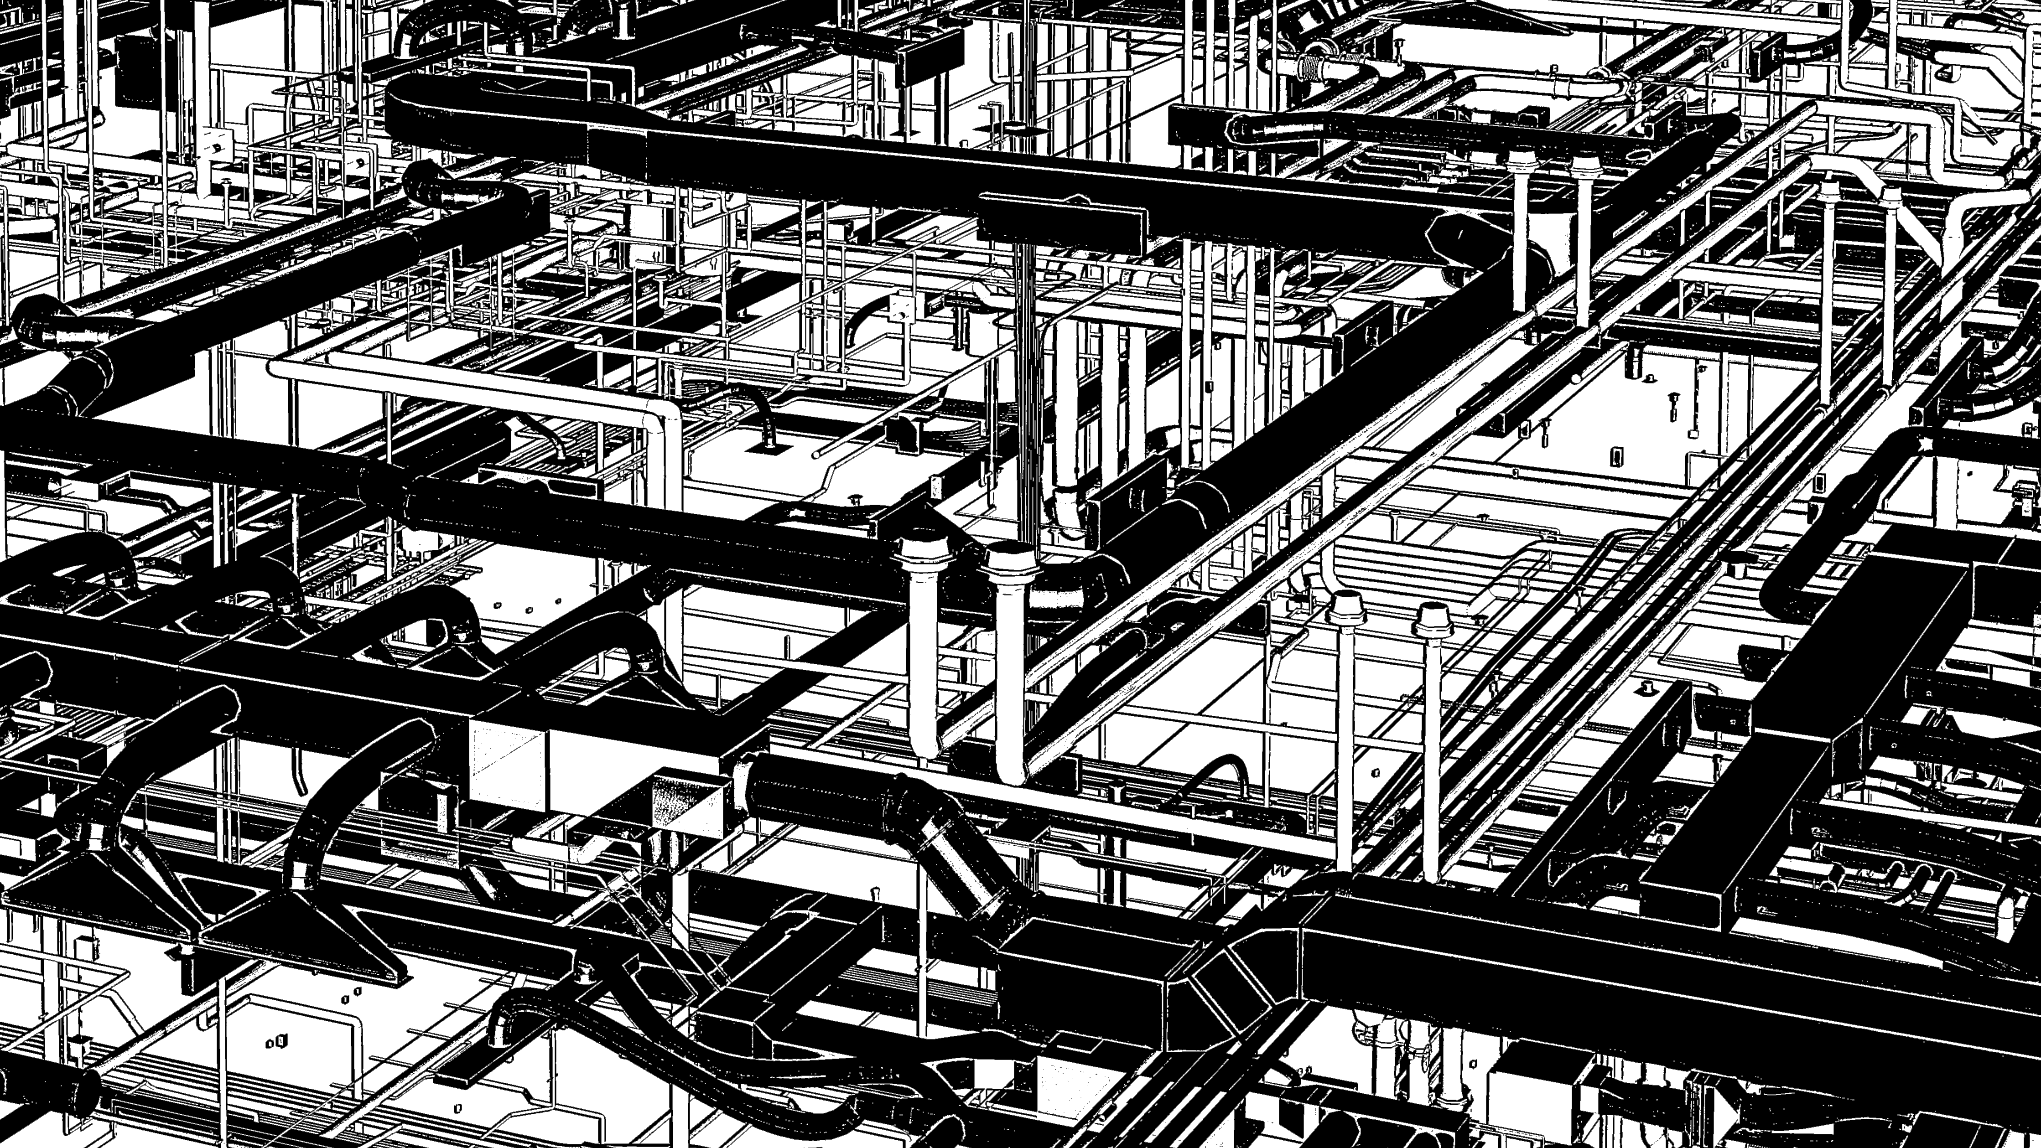
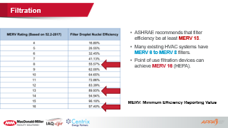
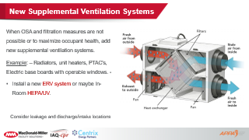
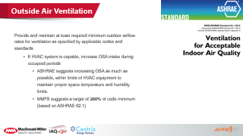
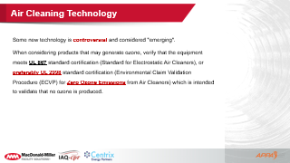
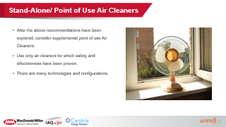
Recommendation #2:
Ventilation, Filtration, Air Cleaning
3. New Supplemental
Ventilation Systems
Outside Air (OSA)
2. Filtration
4. Stand-Alone /
Point of Use Air Cleaners
5. Air Cleaning Technology
Notes:
Seth OSA- ben filtration/ supplemental/ Seth- Stand-alone (systems that can’t increase OSA)

Slide 13
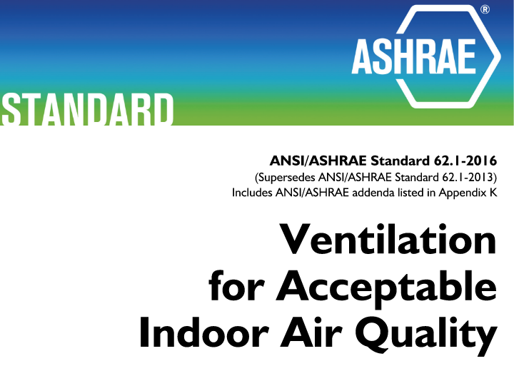

Outside Air Ventilation
Provide and maintain at least required minimum outdoor airflow rates for ventilation as specified by applicable codes and standards
  If HVAC system is capable, increase OSA intake during occupied periods
    ASHRAE suggests increasing OSA as much as possible, within limits of HVAC equipment to maintain proper space temperature and humidity limits.
    MMFS suggests a target of 200% of code minimum (based on ASHRAE 62.1)
Notes:
Seth- In our experience building will struggle during summer/ winter with too much OSA. We have a tool to evaluate your building and recommend the layers of components.

Slide 14

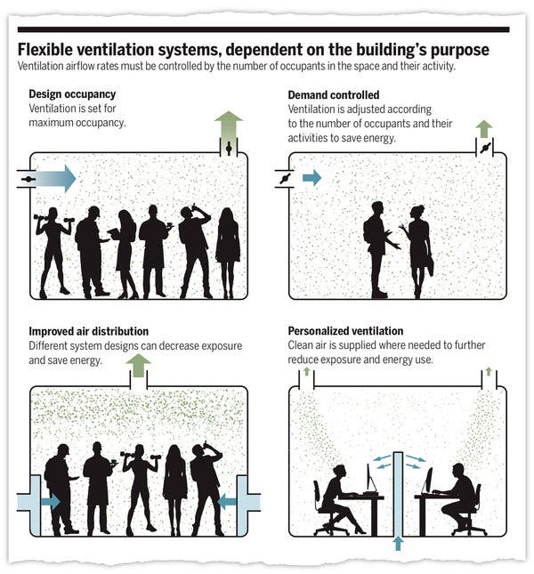
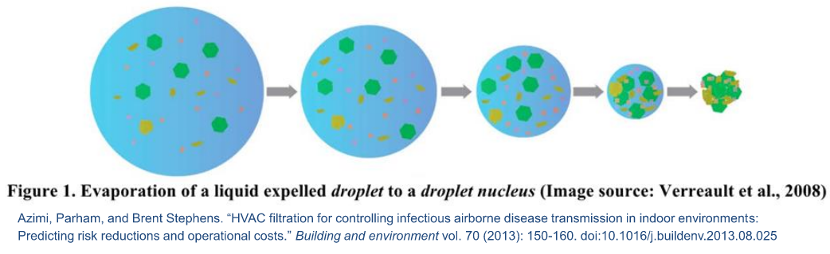
Dilution is the Solution
Increase Ventilation air rates
Confirm vents are moving air
Increase fan runtimes before/ after daily occupancy
Evolution from Droplet to Droplet Nucleus
Notes:
Seth- Droplets start wet then dryout- nucleus is then free to attach and move around. Ventilation systems play a big role in virus transmission.

Slide 15
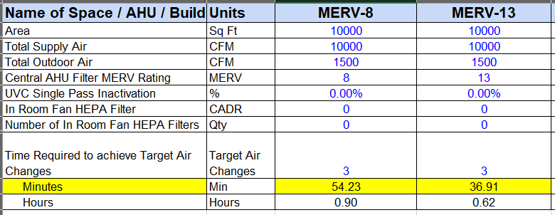
  One Post occupancy flush is recommended with three air changes of clean supply air.
    1 hour Minimum is a good estimate to start. MERV-8 Filters.
    High Eff. Filters and air cleaners can contribute to "Equivalent Outdoor Air" calculations to reduce flushing times.
Notes:
Seth- Layering systems will help to save energy. We have a tool to calculate flushing times based on different input variables

Slide 16
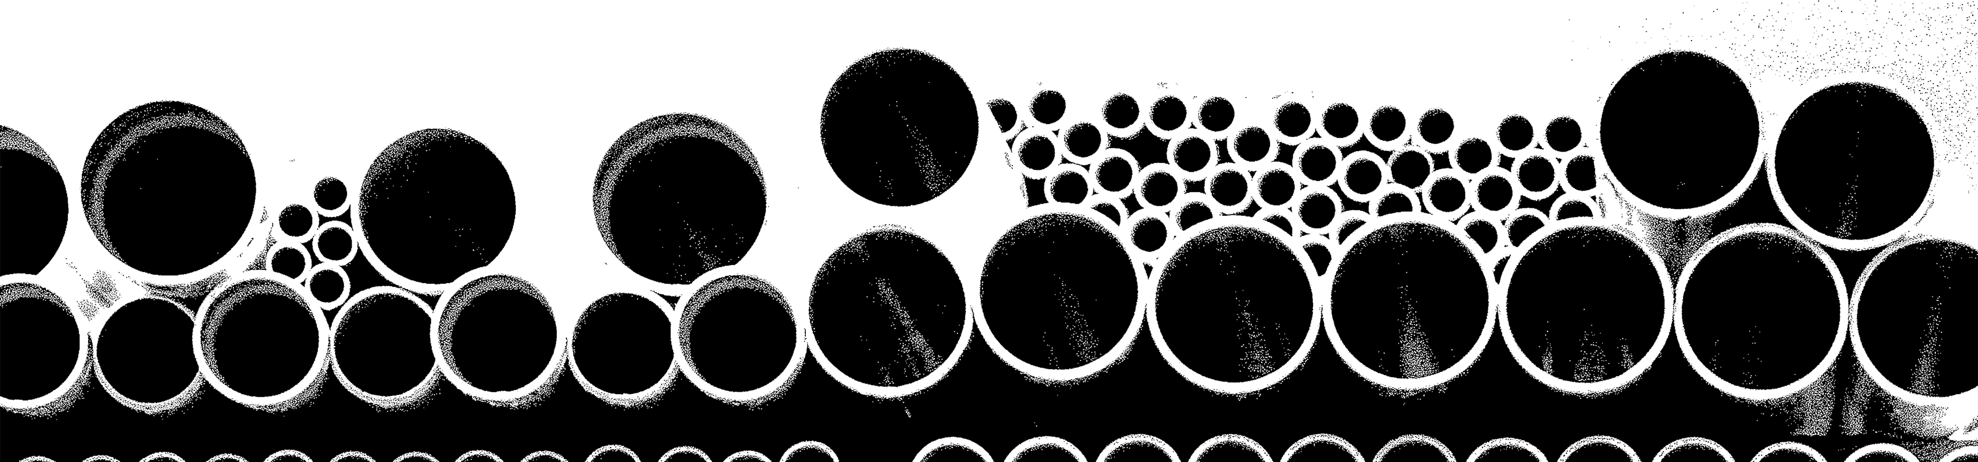
PROS
CONS
Clean/ Fresh Air Indoors
Dilution of Indoor Air Contaminants
Reduced Chance of Virus Recirculation
Reduced Flushing Times
Energy to Condition OSA
OSA Contaminants – Wildfires etc.
Indoor Temperature Problems
Notes:
Seth

Slide 17
MacMiller Recommendations- OSA
Test/confirm current OSA intake levels- Document results
Adjust OSA settings on existing equipment- Document
Establish system control modes/protocols
  How your systems should be postured for extreme scenarios and what steps need to be taken.
  Prepare for the next time.

Slide 18
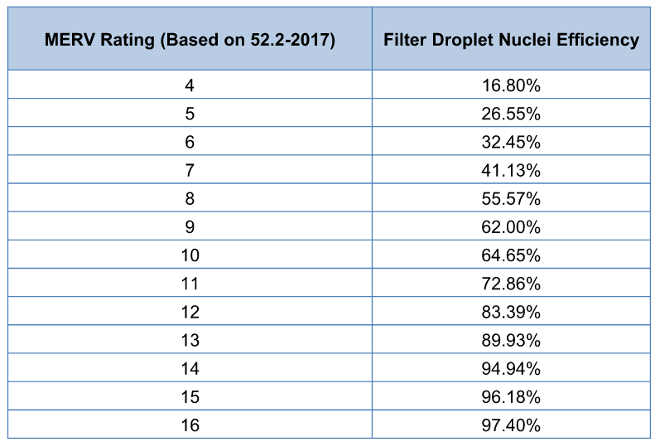
Filtration
ASHRAE recommends that filter efficiency be at least MERV 13.
Many existing HVAC systems have MERV 6 to MERV 8 filters.
Point of use filtration devices can achieve MERV 16 (HEPA).
MERV: Minimum Efficiency Reporting Value
Notes:
Ben-

Slide 19
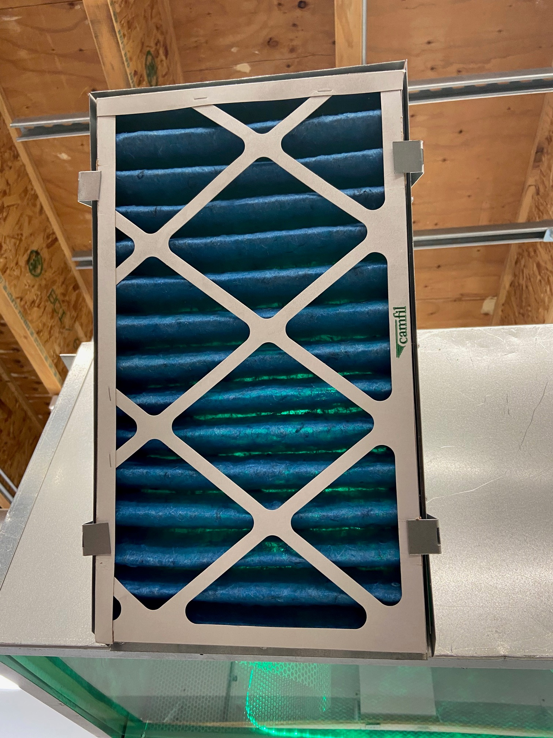
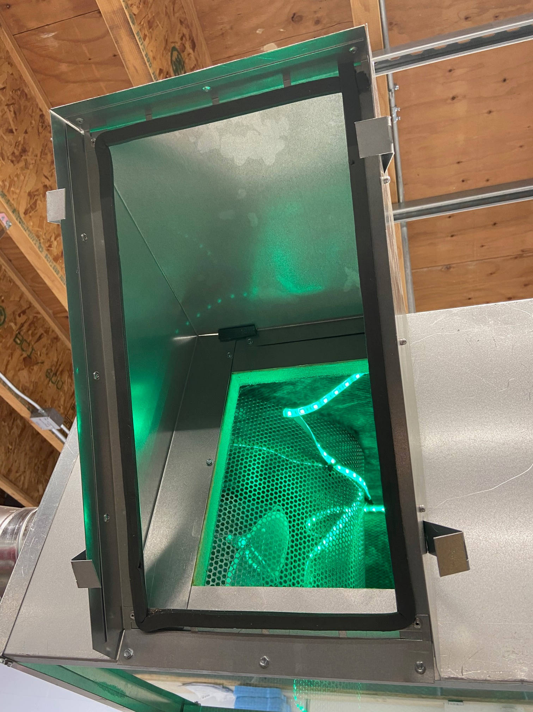
Capable units* :
RTU VAV, Large fan coils, Gas packs, Central AHU’s, Split system AHU’s, Water source HP
Non-capable Units:
VAV Fan Powered Terminals, VRF Terminals/fancoils, PTAC, Window AC units, Unit Heaters, Radiators
*The fan is generally capable- other modifications may be necessary
Filtration
Higher efficiency does not come without a penalty.
Care must be taken when increasing the filter efficiency.
Filters must fit tightly
Notes:
Ben.

Slide 20
PROS
CONS
Minimal System Modification
Cleaner Air Through System
Cleaner Air in Building
Not All Systems Will Accept
Energy Penalty
Not clear that virus is dangerous when distributed through a duct system.
Notes:
Ben

Slide 21

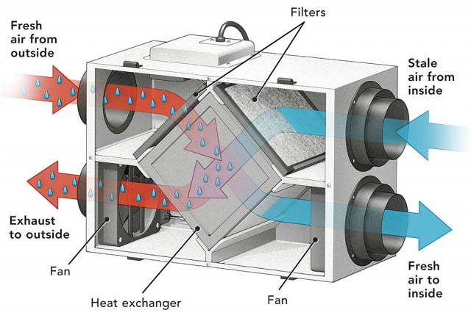
New Supplemental Ventilation Systems
When OSA and filtration measures are not possible or to maximize occupant health, add new supplemental ventilation systems.
Example: – Radiators, unit heaters, PTAC's, Electric base boards with operable windows. -
Install a new ERV system or maybe In-Room HEPA/UV.
Consider leakage and discharge/intake locations
Notes:
Ben

Slide 22
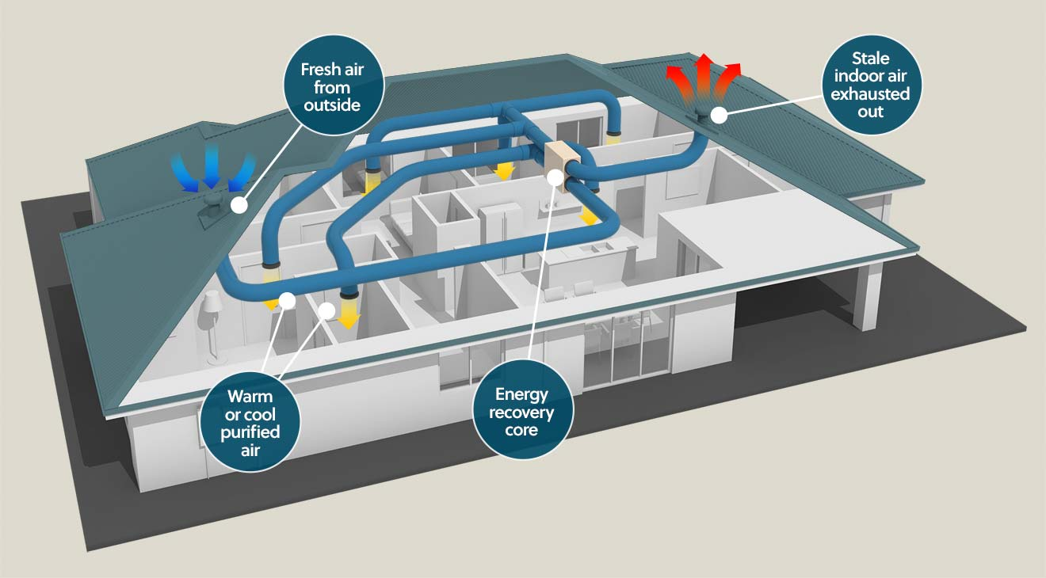
Energy Recovery Ventilation (ERV) system
Notes:
Ben

Slide 23
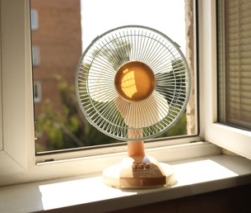
Stand-Alone/ Point of Use Air Cleaners
After the above recommendations have been explored, consider supplemental point of use Air Cleaners.
Use only air cleaners for which safety and effectiveness have been proven.
There are many technologies and configurations.
Notes:
Seth- Old school tech- still works- Point out school article (Ben)

Slide 24
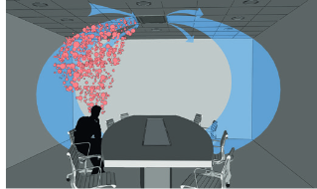
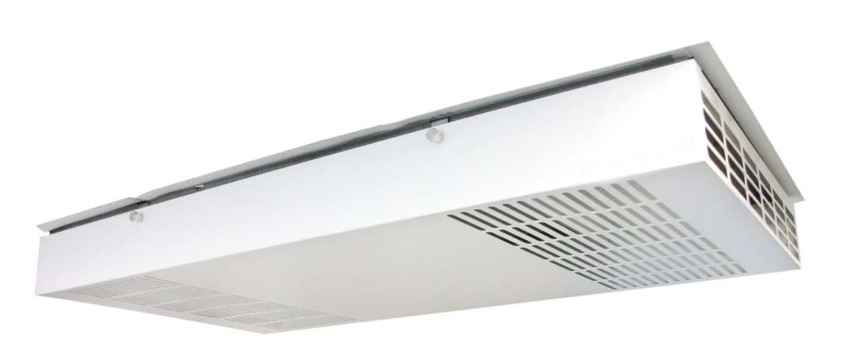

MacMiller Recommendations
Ceiling mounted recirculation fan with HEPA and UVGI.
Notes:
Seth- In-Room

Slide 25
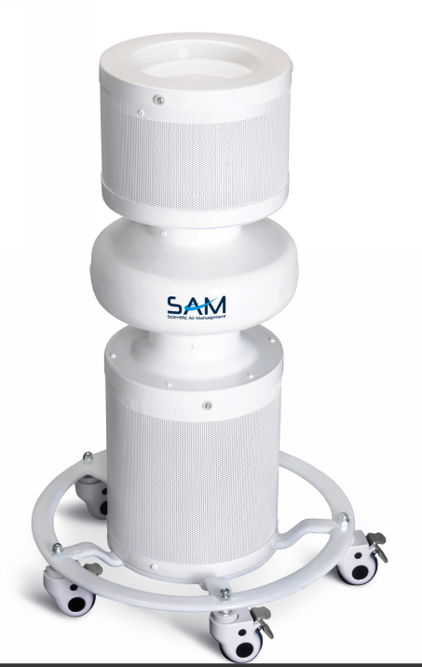
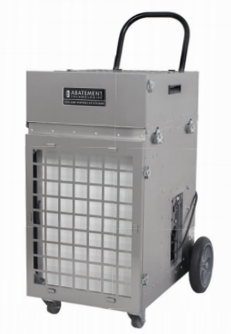
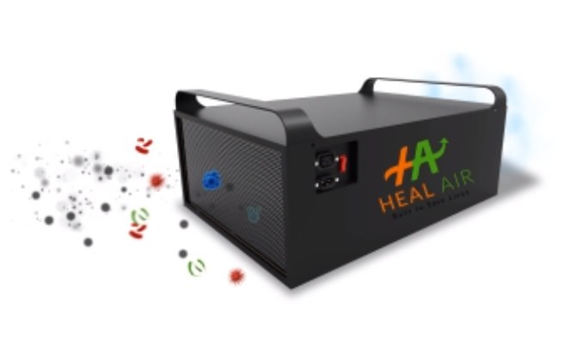
MacMiller Recommendations
Fixed outside air systems – like VRF with minimum DOAS. - Install IR or HEPA/UV.
Portable HEPA
Hanging HEPA and UVGI
Portable HEPA and UVGI
Notes:
Seth- mention UVC and foreshadow for Bens talk of UVC

Slide 26
Air Cleaning Technology
Some new technology is controversial and considered "emerging".
When considering products that may generate ozone, verify that the equipment meets UL 867 standard certification (Standard for Electrostatic Air Cleaners), or preferably UL 2998 standard certification (Environmental Claim Validation Procedure (ECVP) for Zero Ozone Emissions from Air Cleaners) which is intended to validate that no ozone is produced.
Notes:
Ben

Slide 27
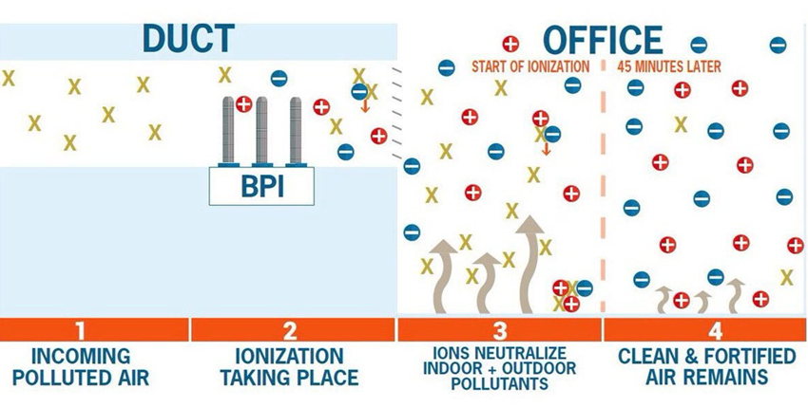

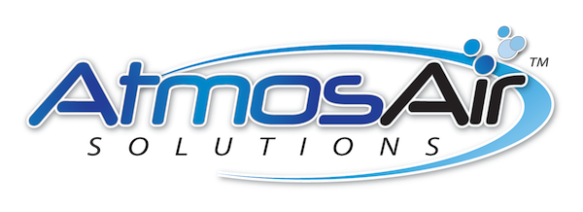

Bi-Polar Ionization
Releases Positive and Negative Ions into the air
Ions attach to pollutants making them larger and kills virus/bacteria. Also neutralizes some VOC's
Install at a zone level fan
Floods to occupied zone.
Devices MUST be UL 2998 Zero Ozone Production
Brands
Notes:
Ben

Slide 28

Contents
A new generation of controlled Ionization that produces a safe Indoor Air Quality environment and saves energy
IAQ-cpr – What Does It mean
Regulated IAQ
IAQ-cpr Disruptive Approach
What Does It Do
State of Current Technologies
Technical Information
Questions & Response

Slide 29

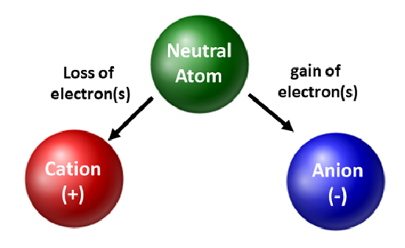
What does IAQ-cpr stand for?
Indoor Air Quality
Cold Plasma Regulation
IAQ’s-cpr’s technology cleans the air by introducing negatively and positively charged ions via the ventilation system
  Killing Pathogens – by binding to the pathogen and disrupting proteins
  Cleaning the air through particulate removal – bundling for removal
  Eliminating Odors – breaking odors down into harmless compounds
  Energy savings - through reduction of outside air required

Slide 30

What does it do?
Our patented technology kills pathogens such as the coronavirus, salmonella, influenza, colds, and mold spores
  We render them inactive by disrupting the pathogen’s surface proteins
  Eliminating their ability to replicate
We also clean the air by bundling microscopic air particulates (agglomeration) to make them much larger so that they can be captured in HVAC filters

Slide 31
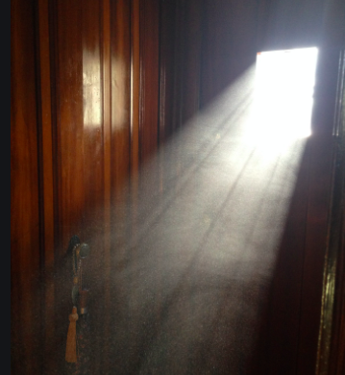
What does it do?
Destroys odors by breaking down the volatile organic compounds (VOCs) found indoors into harmless organic compounds.
Controlled ionization also provides energy savings:
  By balancing the right amount of outside air required to keep the air clean and healthy in the building.
  Regulated reactive oxygen species kills the mold and mildew that clogs the coils in the ventilation system bringing them back to manufacturer’s standards.

Slide 32
State of Current Technologies
While over 250,000+ Ionization systems have been installed, none of these offer regulated independent control of the flow of negative and positive ions.
Generally negative ions last for approximately one minute and positive ions last for up to fifteen minutes depending on space conditions.
Current Ionization systems cannot regulate or control ion output for a consistent and ideal ratio of negative to positive ions.
Most current ionization technologies inherently deliver an indoor air environment with a high positive to negative ion ratio. High levels of positive ions can cause long-term health effects. (Power Lines)
The optimum rate for a normal facility is a 2:1 ratio of negative to positive ions.

Slide 33

IAQ-cpr Disruptive Regulated Ionization Approach
IAQ-cpr has recognized and solved the inherent toxicity problem of existing Needle Point Bi-Polar Ionization (NBPI), Bi-Polar Ionization (BPI) or Cold Plasma Generation (CPG) systems.
We have secured the only industry patents to control and regulate the number of positive and negative ions in the space.
We have also developed and secured the only patent in the industry for both a separate negative and positive ion generator.
The IAQ-cpr approach is unique with its proactive algorithm. We can anticipate and control the optimum amount of positive and negative ion generation for optimal Indoor Air Quality.

Slide 34

What is Unique About Regulated Ionization?
In order to create an optimum healthy indoor air environment using ionization, ions must be regulated.
Static output ionization devices have no way to adjust for factors such as temperature, humidity, airflow, etc.
Only controlled ionization offers algorithms that will ramp the ions up or down, or stop generation altogether, to meet optimum conditions.
IAQ-cpr’s patented regulated ionization is the only solution that offers independent control of both the negative and positive ion generators.

Slide 35
What is Unique About Regulated Ionization?
IAQ-cpr’s system will fully integrate with the facility’s existing building management system (BMS).
The system (positive and negative ion generators, sensing group, controller) change ion modulation based on dynamic conditions.
The regulated ionization set meets UL2998 standards, through built in safeties.
The regulated ionization eliminates the risk of ozone production by ensuring operation below 11.9 volts.

Slide 36
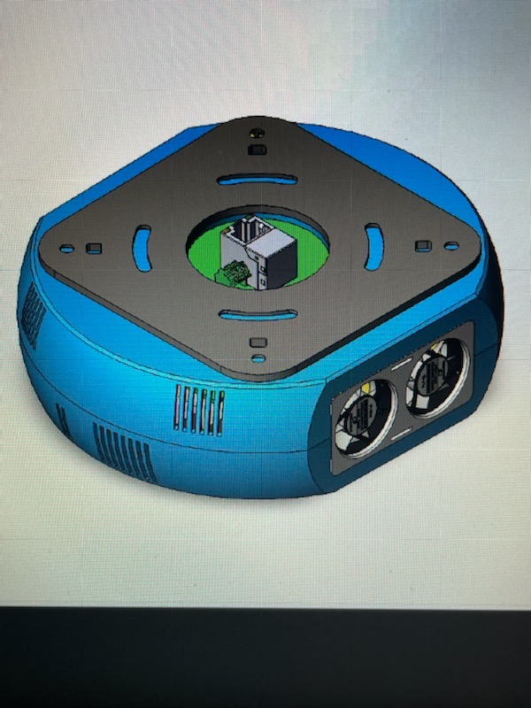
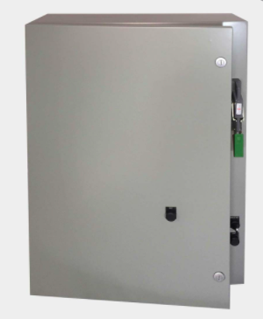

IAQ Cold Plasma Regulation System
Sensing Group
Ion Counter
Air Flow Sensor
Particulate Matter
Temperature
Humidity
Sensing and control for repeatable and consistent IAQ
Variable Output
Positive Ion Generator
Negative Ion Generator
Controller

Slide 37
Key Take Aways
Patented regulated ionization allows for automated control over the conditioned indoor air quality environment
This is the next generation of ionization
Ionization led by science: Measure, Analyze, Adjust, Verify

Slide 38
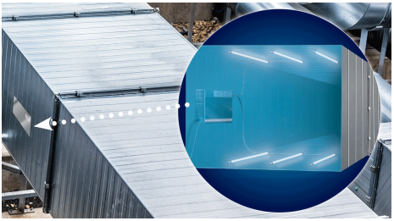
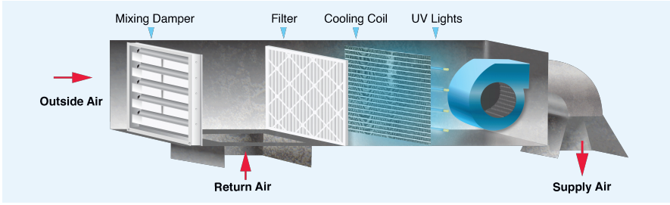
UVGI – Ultraviolet Germicidal Irradiation
UV Disinfection
  Coil Disinfection
  Airstream Disinfection (Kill on the Fly)
    95%+ effective
Notes:
Ben

Slide 39
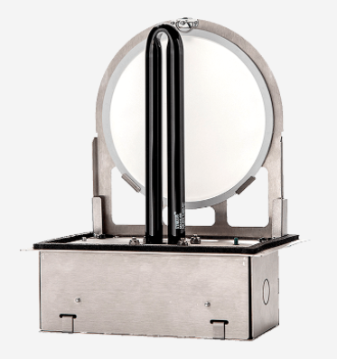

Dry Hydrogen Peroxide (DHP)
Hydrogen peroxide (H2O2) has well known antimicrobial properties.
Devices generate DHP through photocatalytic oxidation (PCO).
These produce hydrogen peroxide in a pure, gaseous form (i.e., not in the form of aqueous solution or aqueous vapor or mist), hence the term “dry.”
Produces constant supply into the air at concentrations 50 times below OSHA standards.
Disinfects air and surfaces it contacts.
      Brand:
Notes:
Ben

Slide 40
PROS
CONS
Ionization | Floods occupied spaces with ions Low Price Point Easy install Self cleaning models available No maintenance Low energy costs
UVC-GI | Kills most airborne pathogens in a single pass
Dry Hydrogen Peroxide | Floods occupied spaces with H2O2. Low energy costs
Ionization | Newer Technology Limited Research on efficacy/safety
UVC-GI | Expensive Energy costs Dangerous to people Only effective on air passing by the light Maintenance costs
Dry Hydrogen Peroxide | Mid priced Maintenance costs Newer technology Limited research on efficacy/safety
Notes:
Ben

Slide 41
ASHRAE Core Recommendations:
1. Public Health Guidance
Follow all regulatory and statutory requirements and recommendations.
2. Ventilation, Filtration, Air Cleaning
Increased levels for
added safety.
3. Air Distribution
Avoid strong currents that may
increase direct transmission.
4. HVAC System Operation
Utilize system controls and operational sequences to maximize effectiveness.
5. System Commissioning
Verify HVAC systems
are functioning as designed.
https://www.ashrae.org/file%20library/technical%20resources/covid-19/core-recommendations-for-reducing-airborne-infectious-aerosol-exposure.pdf

Slide 42
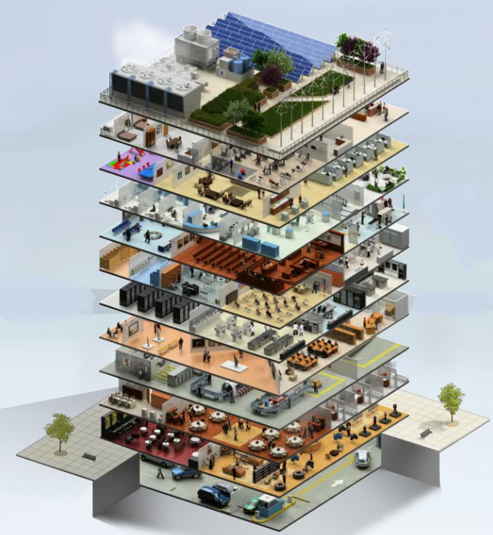
#4 HVAC System Operation
Building Controls
Does your building have digital environmental controls?
Yes? Great, optimize them.
No? Consider upgrading.
Notes:
Seth- lets talk about buildings that have controls. We can certainly add controls- different conversation

Slide 43
Building Controls
Managing building IAQ is challenging w/o digital controls
Benefits of digital controls
  Systemic adjustments
  Smart sequences to maximize
  energy savings*
  Programmed operational modes
  Utility rebates
  System performance trending
* See ASHRAE Guideline 36-2018, High-Performance Sequences of Operation for HVAC Systems
  Predictive analytics
  Water usage
  Carbon footprint and EUI dashboards
  Air quality monitoring
  Demand control ventilation
  Lighting controls
Notes:
Seth- Michael may add to conversation

Slide 44
Building Controls
Modes for external conditions
Normal Mode: Balance of comfort and efficiency Reduced use of air cleaners Normal ventilation Normal Demand Control Ventilation (DCV) Disable/reduce air cleaners | Pandemic Mode: Maximizes Occupant Safety Increased OSA during occupancy Post occupancy flush and extended operation times Overrides DCV Enable air cleaners | Wildfire Mode: Maximizes Indoor Air Quality Reduced OSA rates DCV enabled Enable air cleaners
What other modes might be useful?
Notes:
Seth- Performance mode/ sports mode/ energy saving mode/ If time mention how classrooms could save energy and have a competition between rooms for least energy use

Slide 45
References
https://www.cdc.gov/coronavirus/2019-ncov/community/schools-childcare/index.html
https://www.ashrae.org/technical-resources/resources
https://www.ashrae.org/about/news/2020/ashrae-introduces-updated-reopening-guide-for-schools-and-universities
https://www.ashrae.org/about/news/2020/ashrae-issues-statements-on-relationship-between-covid-19-and-hvac-in-buildings
https://www.ashrae.org/about/news/2020/ashrae-offers-covid-19-building-readiness-reopening-guidance
https://www.iaq-cpr.com/
https://www.uvdi.com/hvac/airstream-disinfection/v-max-grid/
https://www2.ed.gov/about/offices/list/ope/arpa1allocationtable.pdf
https://www.tips-usa.com/search.cfm?SearchRecords=macdonald+miller
Notes:
Who is taking referances

Slide 46
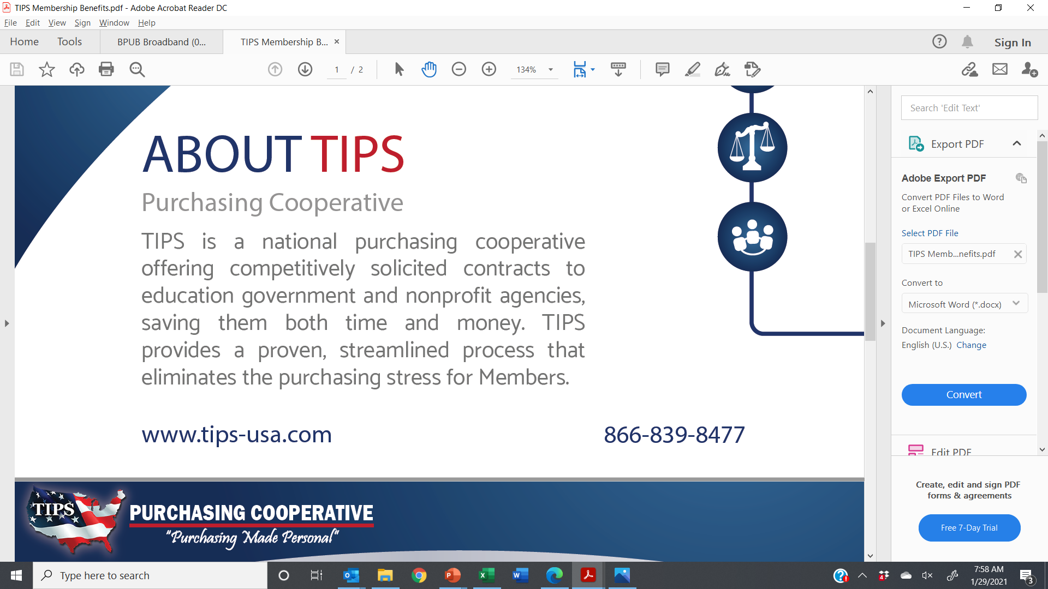

TIPS Purchasing Cooperative
Contract #200201 - Trades, Labor, and Materials (JOC)
Contract #200701 - Indoor Air Quality Equipment and Services

Slide 47
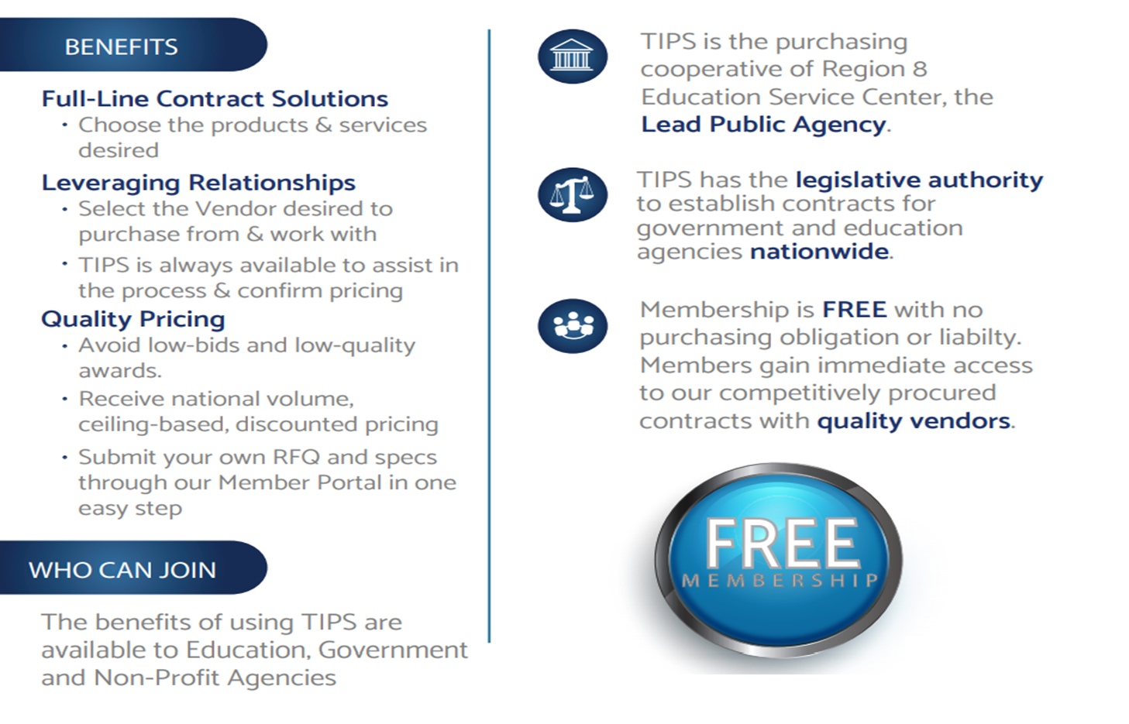
TIPS Purchasing Cooperative

Slide 48


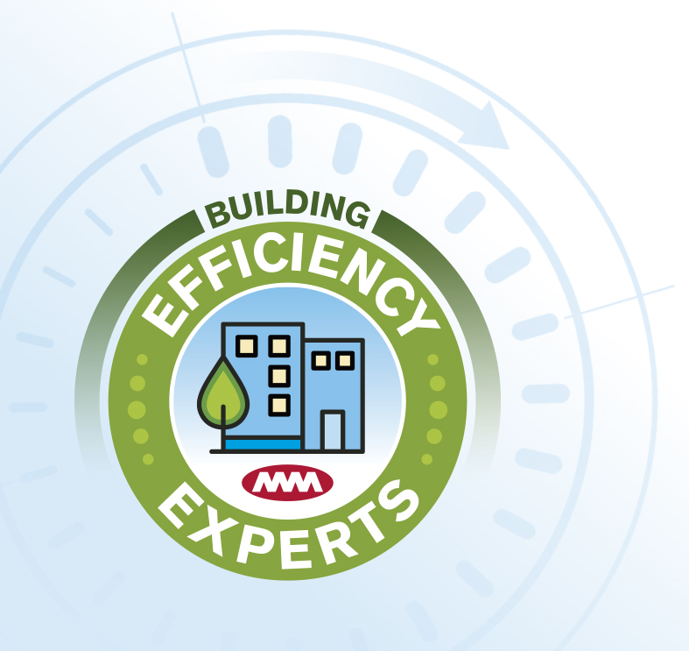



Slide 49

Why an ESCO as your Asset Planning & Project Delivery Partner?
What is the Performance Contracting (PC/ESCO) delivery model?
  Simply stated, PC is a method for contracting building retrofit projects under an umbrella of guaranteed energy savings, costs and system performance with or without third-party funding.
When does it make sense?
  When a partnership is important
  Capital funding constraints
  Energy & Asset Planning with Budgets
  Time sensitive projects (Design-build approach of PC allows for schedule compression)
  Ability to protect investment (systems performance and savings guarantee)
  Looking for ways to improve financial proforma (leverage grants, rebates, funding).

Slide 50


What’s needed for Energy Star?
• Property Name
• Property Address
• Gross Floor Area Heated/Cooled
• Year Built
• Occupancy Percentage
• 12 Consecutive Months of Utility Data
• Weekly Operating Hours
• Estimated Number of Computers

Slide 51
We are here to help you navigate
Energy Star Portfolio Manager
Sharing an Existing Site ID
Add MacMillerFS to your Portfolio Manager “Contacts”; https://youtu.be/HV5uMS4BndU
Then “Share” your Portfolio Site with MacMillerFS; https://youtu.be/RwW4juBLOnY
For Permissions, specify “Full Access“ to allow MacDonald-Miller updating privileges
Creating a New Site ID
Let MacDonald-Miller do it for you
Or see Energy Star’s “How To” Series; www.energystar.gov/buildings/training/training
When done, add MacMillerFS to your Portfolio Manager “Contacts”; https://youtu.be/HV5uMS4BndU
Then “Share” your Portfolio Site with MacMillerFS; https://youtu.be/RwW4juBLOnY
For Permissions, specify “Full Access” to allow MacDonald-Miller updating privileges

Slide 52
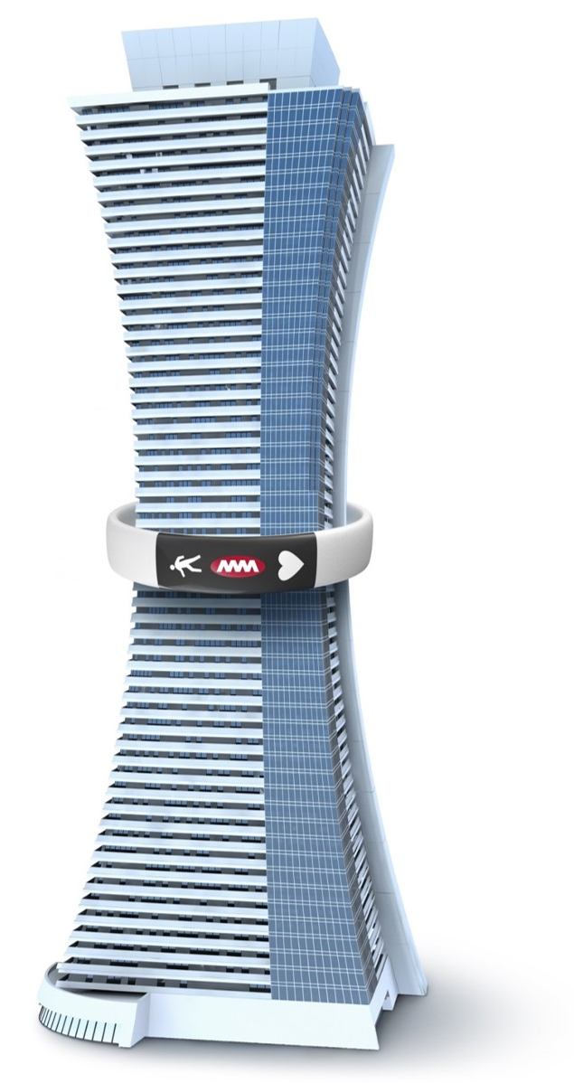
Note: Buildings permitted after July 1, 2016 must perform 15% better than target EUI.
Notes:
Clean Buildings Standard target EUI Examples

Slide 53
Commercial Office Building |  |  |  |  | 2019 EUI: 91
ENERGY EFFICIENCY MEASURE | SCOPE OF WORK DESCRIPTION |  | ROM Cost | ROM Cost | ROM EUI Reduction
 |  |  |  |  | Low | High
INVESTMENT GRADE AUDIT | Investment Grade Scoping, Energy Analysis & Report, Incentive Applications, Preconstruction Services |  | $23,650 | $23,650 | 0 | 0
EEM – 1 | Building Automation Upgrades: Convert pneumatic to DDC, replace VAV terminals, rewrite sequences, replace hydronic control valves & deploy smart building analytics program |  | $1,134,268 | $1,134,268 | 17 | 22
EEM – 2 | Add Heat Reclaim Coil to 24/7 Hydronic Cooling Loop |  | $109,965 | $109,965 | 5 | 6
EEM – 3 | Stack Effect Mitigation and Floor Static Pressure Control |  | $478,282 | $478,282 | 2 | 5
EEM – 4 | LED Lighting Upgrades |  | $986,283 | $986,283 | 6 | 7
ROUGH ORDER MAGNITUDE TOTAL |  |  | $2,732,448 | $2,732,448 | 30 | 40
Post EEM Implementation EUI: | Post EEM Implementation EUI: |  |  |  | 61 | 51
 |  |  | Target EUI: |  |  | 63

Slide 54
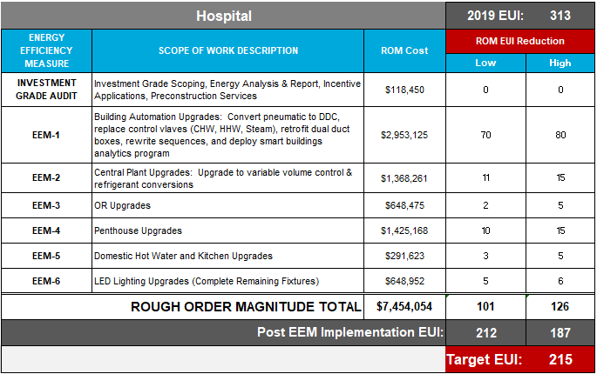
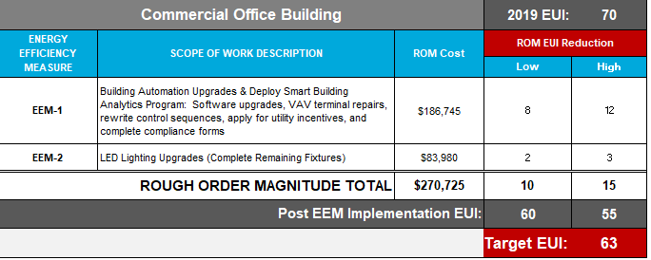
Scenario 1: Capital Improvement Plan
EUI > 10% of Target EUI.
Schedule, fund and implement improvements over 3 years.
Allow a minimum of 6 months to tune building systems prior to commencing 12-month performance period.
Submit paperwork to Commerce prior to mandatory compliance date.
Scenario 2: Operating Budget Plan
EUI < 10% of Target EUI.
Implement smart building analytics to identify and prioritize implementation of improvements.
Continuously measure impacts of efforts to achieve Target EUI.
Submit paperwork to Commerce prior to mandatory compliance date.

Slide 55

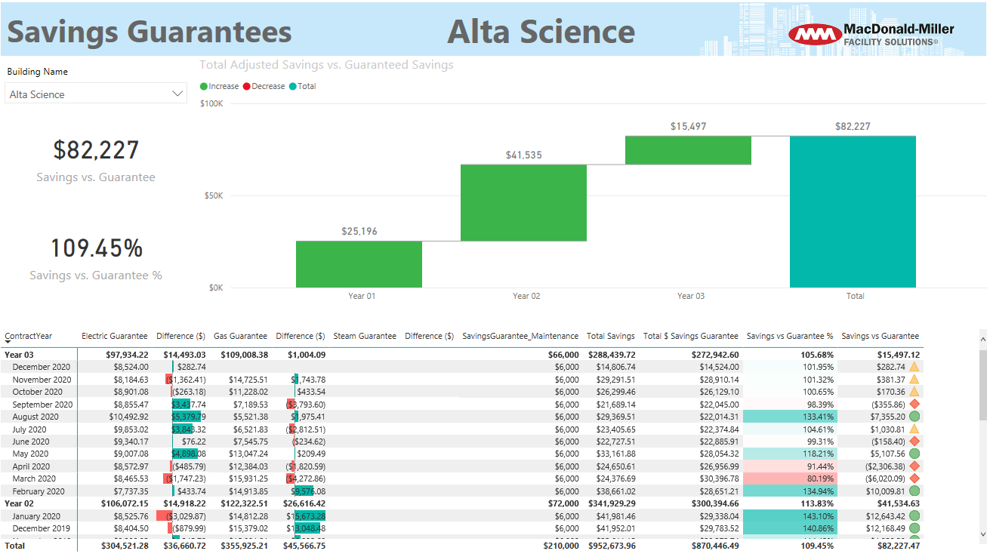



Utility Report Card
DASHBOARDS

Slide 56

  We're Here To Help
www.macmiller.com
MacDonald-Miller Service:
1-855-MAC-HVAC
Contact us:
Michael Coffey,
ESCO - Account Executive
Michael.coffey@macmiller.com
206-387-2022
Christian Barlow,
Board Chairman
christian@iaq-cpr.com
512-648-0371
Adam Corwin,
Centrix
adam@centrix-energy.com
813-334-5356

